Slide 1
Real World Polyglot Persistence
Jimmy Bogard
@jbogard
jimmybogard.lostechies.com

Slide 2
What is NoSQL?
Not relational
Built for scale
Typically schemaless

Slide 3
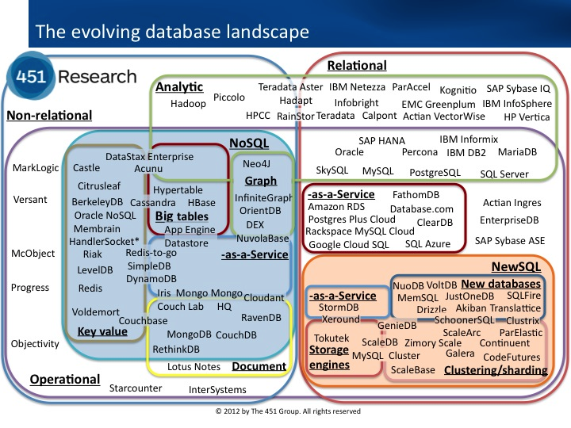
NoSQL Families

Slide 4
Relational Models

Slide 5
Key/Value Stores
[Bucket = AspNetSession]
[Key = AspNetSession/8uhwe9fjs93]
[Value = RedisSessionState]

Slide 6
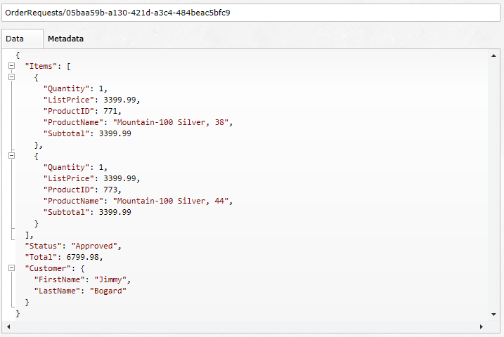
Document Database

Slide 7
Graph Database
ProductId:23
ProductId:24
ProductId:771
ProductId:989
ProductId:65

Slide 8
Challenges

Slide 9



Availability/support

Slide 10

FUD

Slide 11
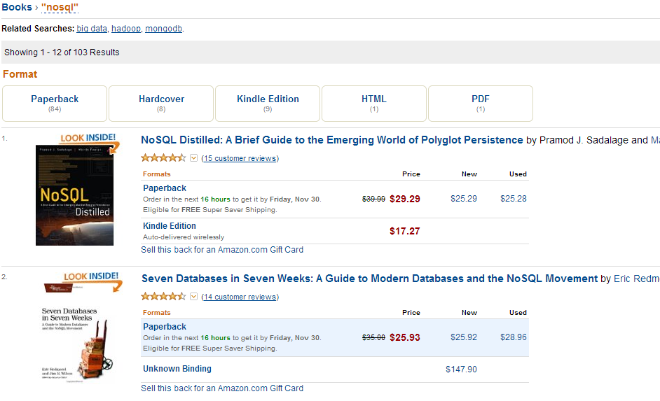
Expertise

Slide 12
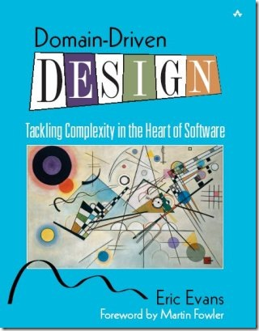
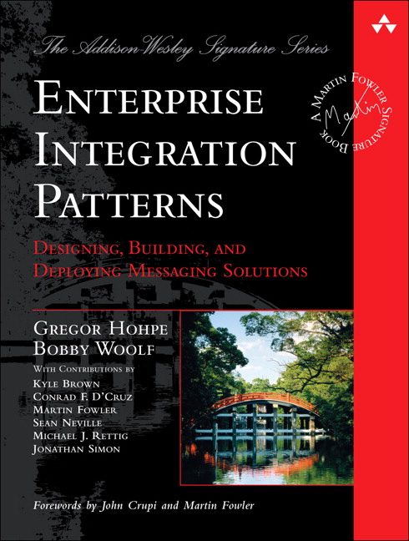
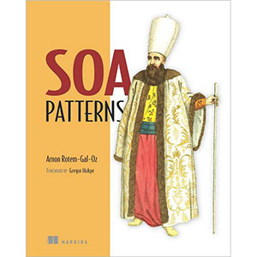
Putting it together

Slide 13
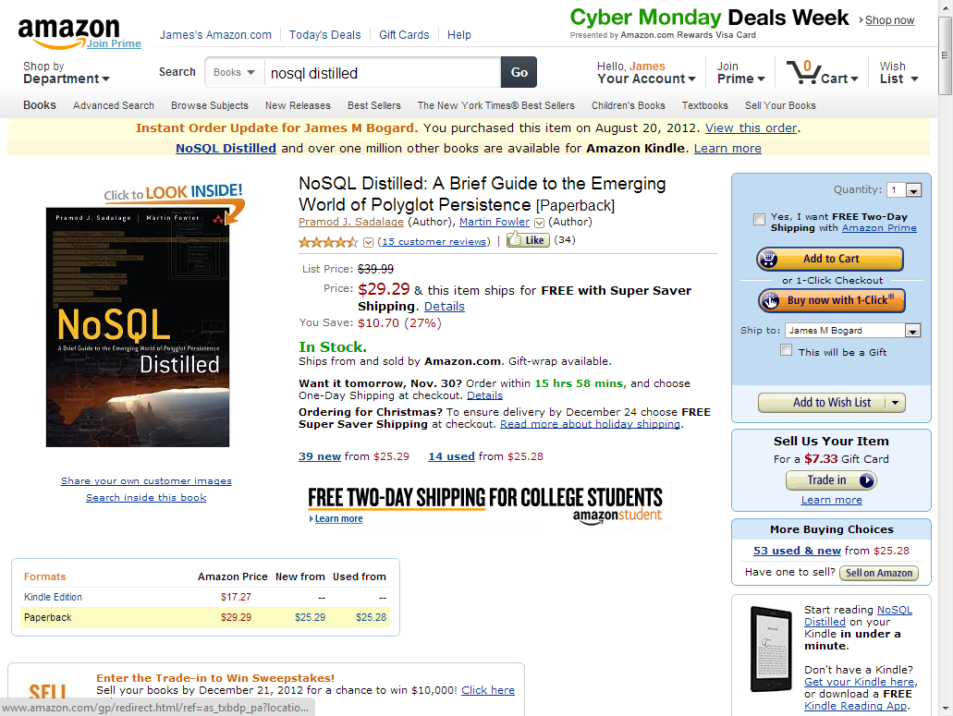
Amazon example

Slide 14
Flipping N-Tier
UI
BL
DAL
DB

Slide 15
Sample App

Slide 16

Please Leave Feedback During Q&A
If you leave session feedback and provide contact information, you will be qualified for a prize
Scan the QR code to the right or go to bit.ly/htf130408

